Slide 1



APEX INSTITUTE OF TECHNOLOGY
DEPARTMENT OF COMPUTER SCIENCE & ENGINEERING
Database Management System (22CSH-243)
Faculty: Ms. Shaveta Jain (13464)
BCNF & De-NORMALIZATION
DISCOVER . LEARN . EMPOWER

Slide 2
DBMS: Course Objectives
COURSE OBJECTIVES
The Course aims to:
Understand database system concepts and design databases for different applications and to acquire the knowledge on DBMS and RDBMS.
Implement and understand different types of DDL, DML and DCL statements.
Understand transaction concepts related to databases and recovery/backup techniques required for the proper storage of data.

Slide 3
COURSE OUTCOMES
On completion of this course, the students shall be able to:-
CO3 | Apply relational algebra and relational calculus to query the database of organization

Slide 4
Outline
General Normal Form Definitions
BCNF (3.5NF)
BCNF Summary
De-Normalization
Typical Denormalization Techniques
Problems of De-normalization
Chapter 10-<number>

Slide 5
General Normal Form Definitions (For Multiple Keys)
The above definitions consider the primary key only
The following more general definitions take into account relations with multiple candidate keys
A relation schema R is in second normal form (2NF) if every non-prime attribute A in R is fully functionally dependent on every key of R
Chapter 10-<number>

Slide 6
General Normal Form Definitions
A relation schema R is in Third Normal Norm (3NF) if whenever a FD X -> A holds in R, then either:
(a) X is a Superkey of R, or
(b) A is a Prime Attribute of R
NOTE:
Boyce-Codd Formal Form (BCNF) disallows condition (b) above
Chapter 10-<number>

Slide 7
BCNF (3.5NF)
BCNF was developed in 1974 by Raymond F. Boyce and Edgar F. Codd to address certain types of anomalies not dealt with by 3NF as originally defined.
BCNF is an extension to 3NF and is slightly stronger than 3NF
BCNF doesn’t allow Non-prime attribute Prime Attribute

Slide 8
Boyce-Codd Normal Form (BCNF)
A relation schema R is in BCNF:-
  if an FD X -> A holds in R, then X is a Superkey of R
The second point sounds a bit tricky, In simple words, it means, that for a dependency X → A, X cannot be a non-prime attribute, if A is a prime attribute.
Chapter 10-<number>

Slide 9
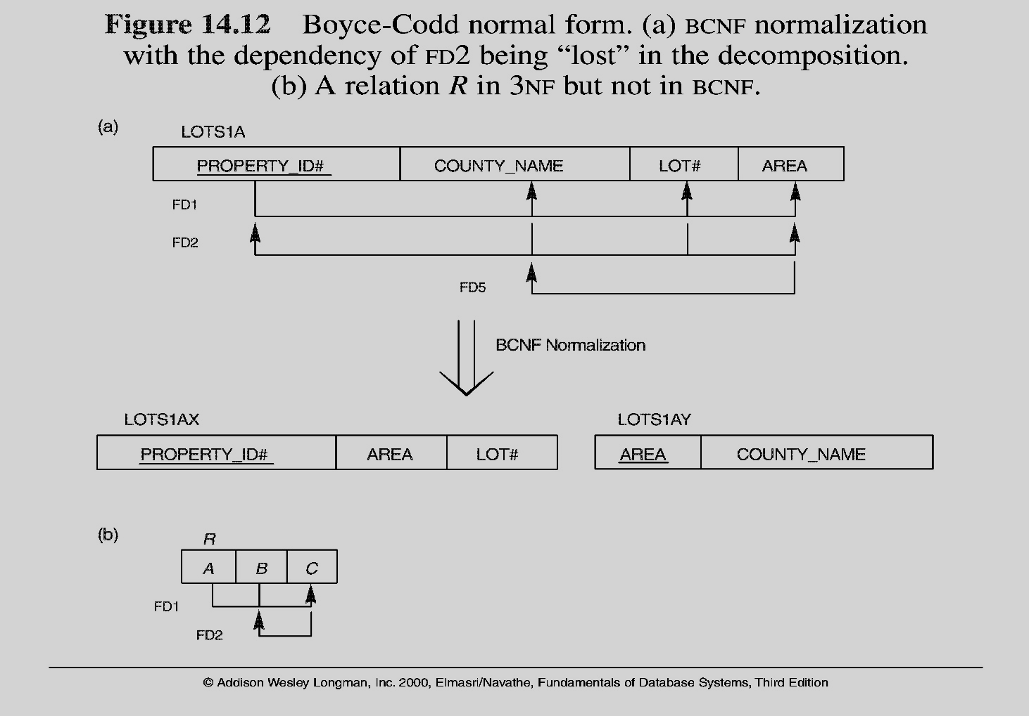
Boyce-Codd Normal Form
(a) BCNF Normalization with the dependency of FD2 being “lost” in the De-Composition
(b) A relation R in 3NF but not in BCNF
Note: The above figure is now called Figure 10.12 in Edition 4
Chapter 10-<number>

Slide 10
BCNF Summary
Each normal form is strictly stronger than the previous one
  Every 2NF relation is in 1NF
  Every 3NF relation is in 2NF
  Every BCNF relation is in 3NF
There exist relations that are in 3NF but not in BCNF
The goal is to have each relation in BCNF (or 3NF)
If our database will be used for OLTP (on line transaction processing), then BCNF is our target. Usually, we meet this objective.
However, we might De-Normalize (3NF, 2NF, or 1NF) for performance reasons.
Chapter 10-<number>

Slide 11
De-Normalization
- It causes redundancy, but fast performance & no referential integrity
- De-normalize when
• specific queries occur frequently,
• a strict performance is required and
• it is not heavily updated
-So, de-normalize only when there is a very clear advantage to doing so and document carefully the reason for doing so

Slide 12
Typical Denormalization Techniques
Flatten a repeating group in one table
Instead of
EMP (E#, Ename)
SKILL (E#, Skill)
Use EMP (E#, Skill, Ename) when Emp has a smaller # of attributes.
- This means use Method 2 of 1NF algorithm. But know the danger of this method as we discussed in MVD.

Slide 13
Problems of De-normalization
Makes row longer
Makes data transfer longer
Needs more memory for memory processing
Cause redundancy and expensive update

Slide 14
References
RamezElmasri and Shamkant B. Navathe, “Fundamentals of Database System”, The Benjamin / Cummings Publishing Co.
Korth and Silberschatz Abraham, “Database System Concepts”, McGraw Hall.
C.J.Date, “An Introduction to Database Systems”, Addison Wesley.
Thomas M. Connolly, Carolyn & E. Begg, “Database Systems: A Practical Approach to Design, Implementation and Management”, 5/E, University of Paisley, Addison-Wesley.

Slide 15

THANK YOU
For queries
Email: shaveta.e13464@cumail.in

